Slide 1
FOOD DONATION APPLICATION
GEETHA G 221801011
HARSHITHA R 221801018
JAYANESH D 221801020

Slide 2
INTRODUCTION:
In recent years, the demand for food delivery services has skyrocketed, driven by busy lifestyles and an increasing need for convenience.
Our food delivery app aims to bridge the gap between surplus food and those in need, promoting food security while reducing waste.
The app connects donors, such as restaurants and households, with recipients in nearby areas, ensuring timely distribution of safe, consumable food.
Key features include real-time updates, secure user authentication, and a streamlined interface for easy navigation.
By integrating donor, requestor, and rider roles, the app creates a seamless and efficient process for food donation and delivery.
This project not only contributes to social welfare but also leverages technology to make impactful community contributions.

Slide 3
Existing system:
Existing food delivery systems typically focus on commercial transactions, connecting restaurants with customers via a streamlined order and delivery process. While popular plas and individuals to communities in need. Security measures for data handling, role-based access, and reliable authentication are also limited in some cases, which could risk user privacy. This gap presents an opportunity for a specialized food delivery app that securely connects donors and requestors with dedicated delivery support. By incorporating a model that centralizes donations, logistics, and tracking, our project aims to address these gaps, providing a robust, secure, and accessible platform for food redistributtforms efficiently handle restaurant menus, customer orders, and real-time delivery tracking, they generally do not address food donations or community-based distribution. Food rescue organizations often rely on manual methods or basic apps that lack advanced features like real-time tracking, automated notifications, or integrated donor and recipient roles. Additionally, existing models may not focus on connecting surplus food from small businesseion.

Slide 4
EXISTING SYSTEM – DRAWBACKS:
Lack of Support for Donations: Existing systems are primarily commercial, focusing on paid transactions rather than enabling food donations, which limits their use for community-oriented food distribution.
Manual Processes: Many food rescue organizations rely on manual matching of donors and recipients, leading to inefficiencies and delays in food redistribution.
Limited Tracking and Real-Time Updates: Most platforms lack real-time tracking for donated food deliveries, making it challenging to ensure timely and efficient distribution to those in need.
Inadequate Security and Privacy Measures: Some platforms may not have robust security features, putting user data and sensitive information at risk.

Slide 5
PROPOSED SYSTEM
The proposed food delivery app aims to create an efficient and secure platform for food donation and distribution, addressing key limitations of existing models. The app will have three main user roles: Donor, Requestor, and Rider. Donors can input details like food quantity, type, expiry date, and pick-up location, making donations easily accessible. Requestors can browse available donations and place requests, receiving real-time updates on their transactions. Riders are notified of pick-up and drop-off details, with optimized routes for timely deliveries. Real-time tracking and automated notifications enhance user experience, while JWT authentication and encrypted MongoDB storage secure user data. A chatbot will assist users with queries, and a payment gateway will support optional donations for delivery costs. This system aims to reduce food waste, promote community engagement, and streamline food redistribution.

Slide 6
PROPOSED SYSTEM - ADVANTAGES
Efficient Food Redistribution: The app facilitates the quick and effective transfer of surplus food to those in need, minimizing food waste.
Role-Specific Features: Customized interfaces for donors, requestors, and riders enhance usability and streamline each user’s experience.
Real-Time Tracking and Notifications: GPS tracking and automated notifications keep users updated on donation status and delivery progress, ensuring transparency.
Enhanced Security: JWT authentication and encrypted MongoDB storage safeguard user data, providing a secure platform.
Community Engagement and Sustainability: By connecting donors with recipients, the app supports community-driven food distribution and promotes sustainable practices.

Slide 7
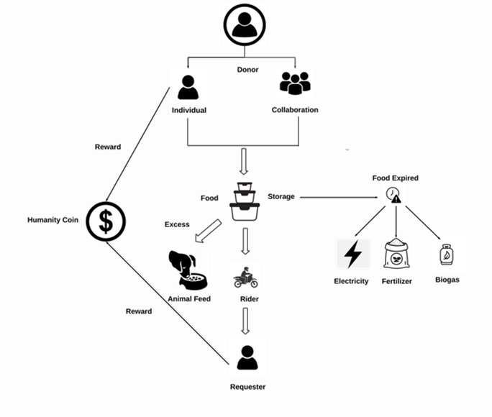
architecture diagram

Slide 8
MODULES
User Management Module:
Purpose: Manages user registration, authentication, and role-specific access for Donors, Requestors, and Riders.
Features: Secure login with , role-based access, and profile management to enhance data security and user personalization.
Donation and Request Management Module:
Purpose: Allows donors to post food donations with specific details and enables requestors to view, request, and confirm these donations.
Features: Donation listing creation, search and filter options for available donations, request confirmation, and real-time status updates.

Slide 9
Delivery Management and Tracking Module:
Purpose: Coordinates the pick-up and delivery process, assigning riders to transport donations to requestors.
Features: Rider assignment, GPS-based tracking for real-time delivery updates, and optimized routing to improve delivery efficiency.
Notification and Communication Module:
Purpose: Keeps users informed on donation status, delivery updates, and other relevant information.
Features: Automated notifications through SMS, email, and in-app alerts to enhance user experience and streamline communication.

Slide 10
JEST TESTING
In our food delivery app project, Jest plays a crucial role in testing and ensuring the reliability of critical features such as user authentication, donation listings, request handling, and notifications. Jest allows us to perform unit and integration testing, verifying that each module works independently and within the app as a whole. With mocking capabilities, Jest simulates database and API interactions, so we can isolate functions and test logic without relying on live data, making tests faster and more focused. Additionally, snapshot testinghelps maintain a consistent UI by capturing component states (like food listings) and highlighting unintended changes. Jest’s ability to run tests in parallel supports an efficient feedback loop, ideal for rapid development cycles. Finally, detailed test reports make it easy to identify issues, streamline debugging, and improve the overall quality and stability of our app for a smooth user experience.

Slide 11
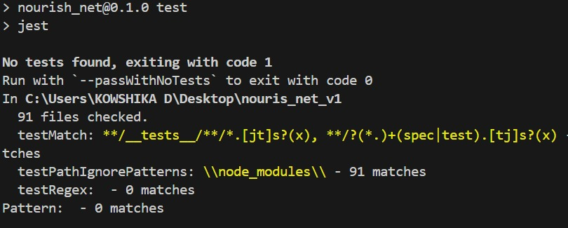
TESTING OUTPUT

Slide 12
WATERFALL MODEL
Implementing the Waterfall Model for our food delivery app project would involve completing each development phase in a structured sequence, ensuring all requirements are addressed before moving to the next stage.
Requirements Gathering: Define all functionalities for Donor, Requestor, and Rider roles.
System Design: Create the architecture, UI, and database layouts.
Implementation: Develop each module based on the design.
Testing: Perform thorough testing to ensure functionality and security.
Deployment: Launch the tested app for real-world use.
Maintenance: Address post-launch updates and bug fixes as needed.

Slide 13
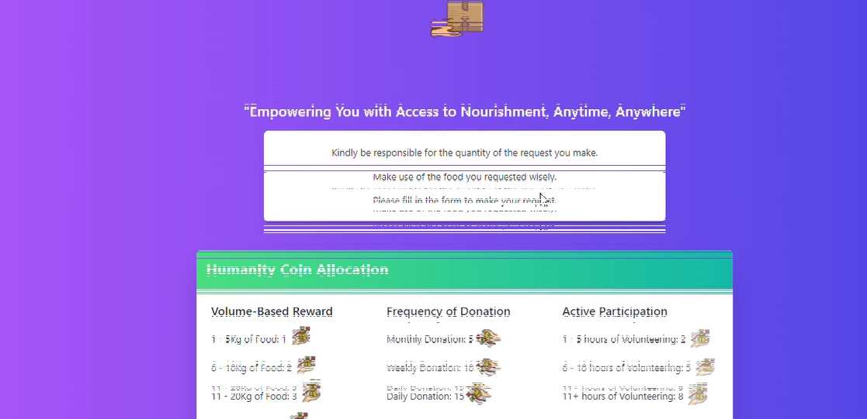
OUTPUT

Slide 14
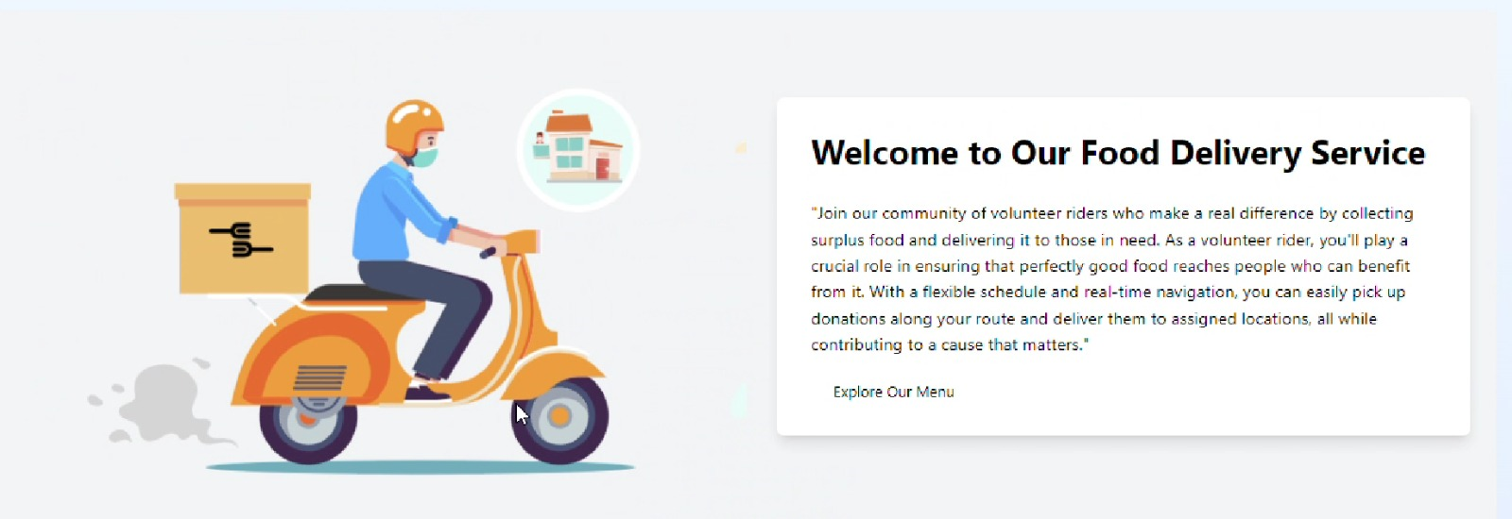

Slide 15
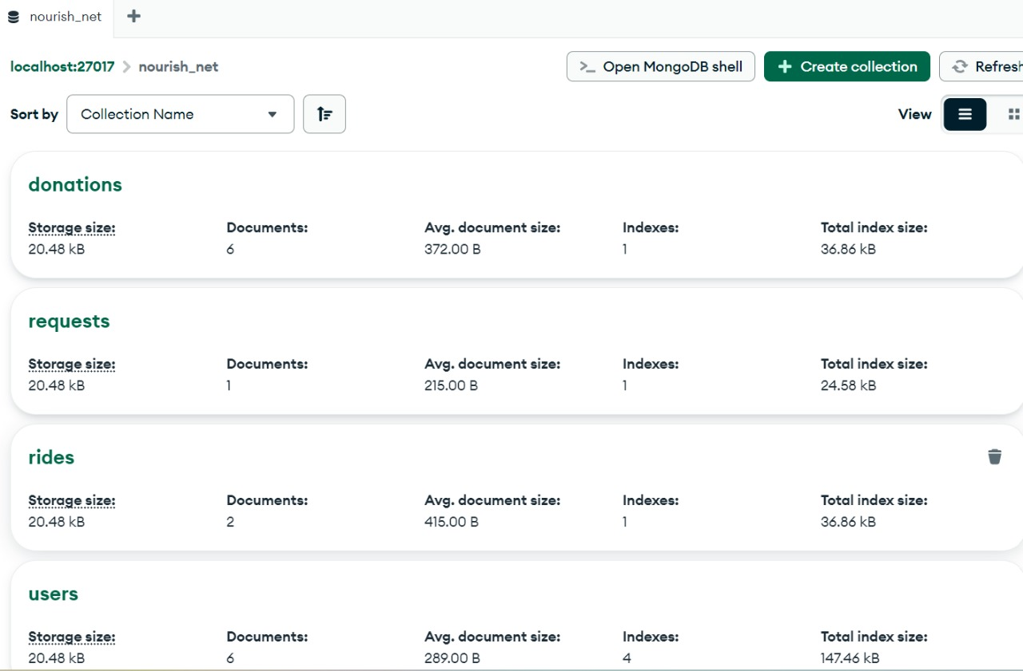
DATABASE

Slide 16
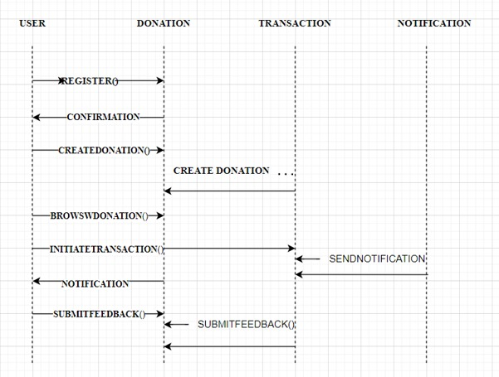
SEQUENCE DIAGRAM

Slide 17
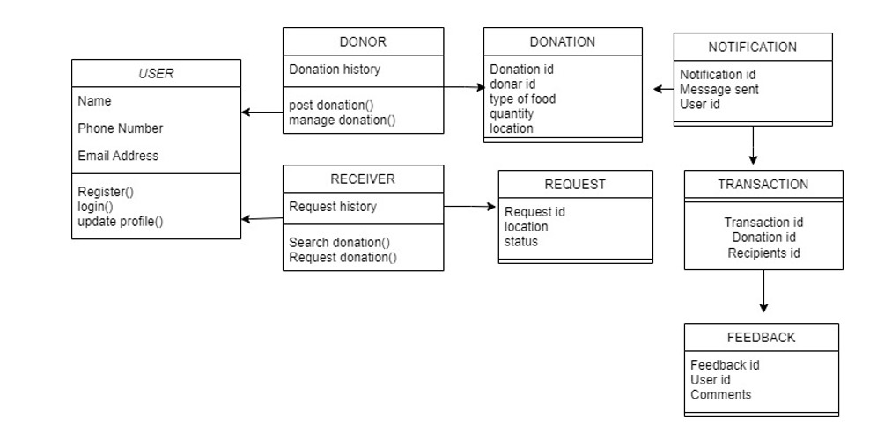
CLASS DIAGRAM

Slide 18
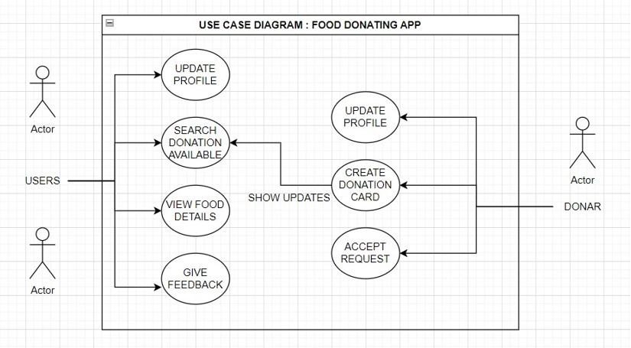
USE CASE DIAGRAM

Slide 19
CONCLUSION
In conclusion, the food delivery app project effectively addresses the need for an efficient, secure, and user-friendly system for food donation and delivery. By integrating key features such as donation management, request handling, and real-time tracking, the app streamlines the entire process for donors, requestors, and riders. The use of Jest for testing ensures robust functionality and reliability, while secure payment gateways protect user data and transactions. The app’s automated processes reduce manual intervention, improving operational efficiency and user satisfaction. Its scalability ensures it can adapt to increasing demand. The project contributes to enhancing food delivery services and offers potential for future improvements, such as AI integration and advanced analytics. This solution provides a foundation for building a more accessible, reliable, and secure food delivery system.

Slide 20
REFERENCES
Anand, R., & Ghosh, S. (2021). "A Comprehensive Study on Food Delivery Applications and Their Impact on Urban Lifestyle." International Journal of Digital Business Management, 12(3), 231-245.
Patel, M., & Sharma, A. (2020). "Emerging Trends in Food Delivery Service and the Role of Technology." Journal of Hospitality and Tourism Technology, 11(4), 411-425.
Roy, S., & Kaur, R. (2019). "The Evolution of Food Delivery Services: A Literature Review." Journal of Foodservice Business Research, 22(2), 129-144.
Johnson, L., & Wang, T. (2022). "Impact of Agile and Waterfall Models on Application Development: A Comparative Study." Software Development Journal, 15(1), 73-88.
MongoDB Documentation. (n.d.). Data Security and Storage Solutions in Web Applications. Retrieved from https://www.mongodb.com/docs.

Slide 21
THANK YOU

